Slide 1
WELCOME

Slide 2
“A Web Site for Bangladesh Metro Rail”
Presented By
Md. Abdul Kayum (201002334)
Section: D-2
Web Programming Lab
GREEN UNIVERSITY OF BANGLADESH
Department of CSE

Slide 3
Content Outline
Introduction
01
Implementation Steps
02
How the Project Works
03
Benefit & Cones
04
Scope of Future Work
05
Q & A
06

Slide 4
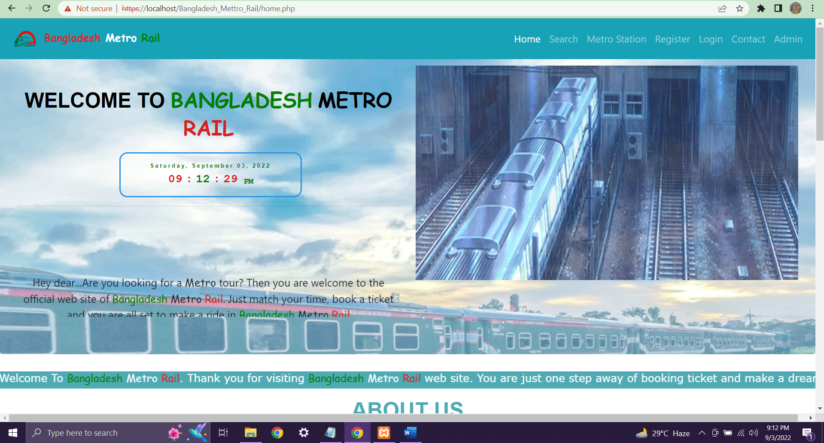
Introduction
Introduction to our project
The Name of Project is “A Web Site for Bangladesh Metro Rail”.
Where booking ticket, all the information of the metro rails, routes and fair will be possible.
PPT Designed by Md. Abdul Kaiyum | 4

Slide 5
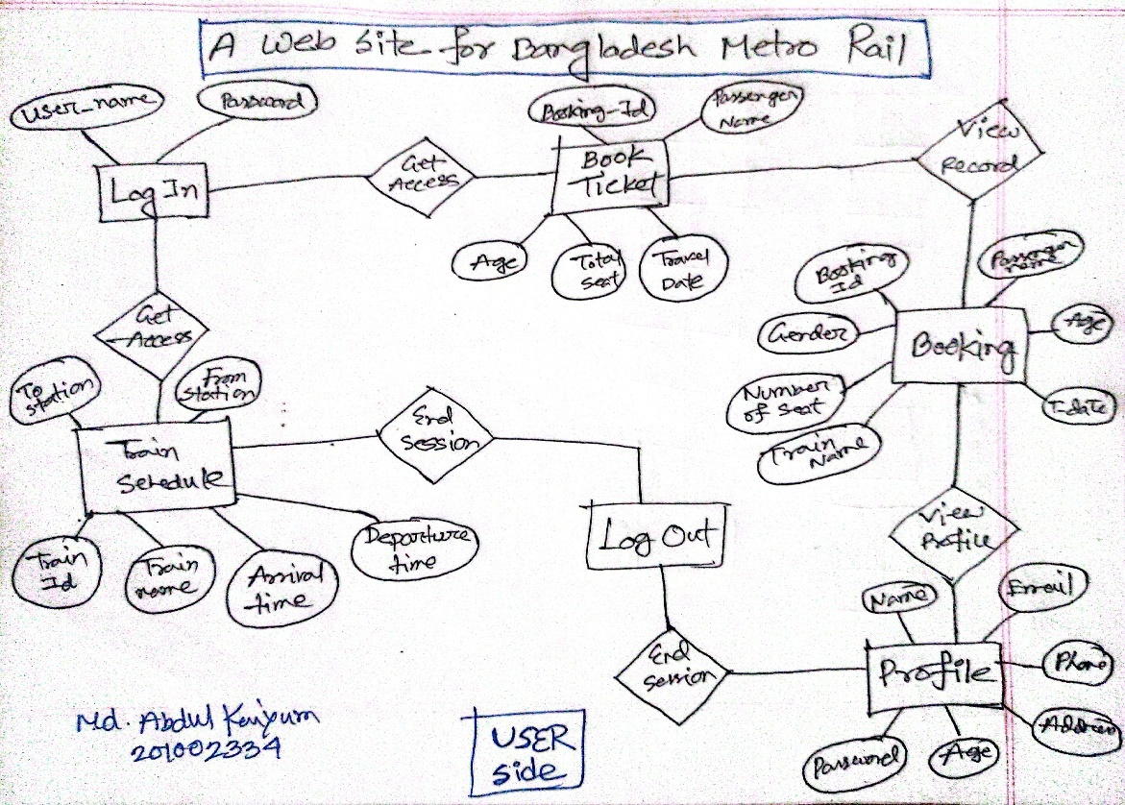
ER Diagram of My Project
PPT Designed by Md. Abdul Kaiyum | 5

Slide 6
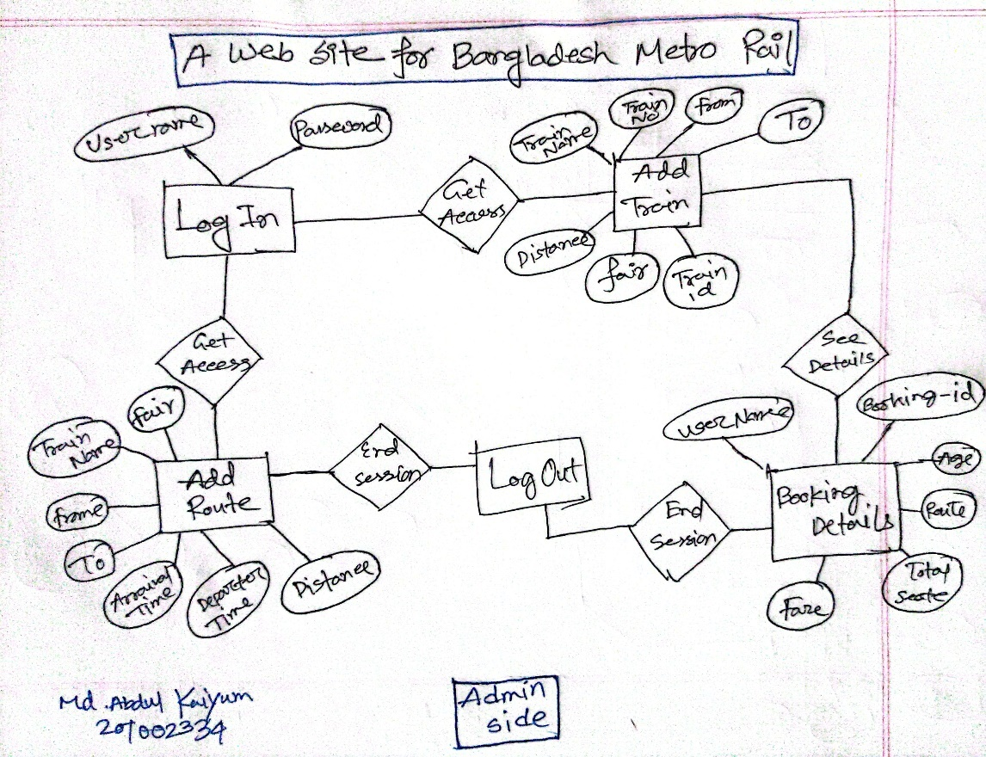
ER Diagram of My Project
PPT Designed by Md. Abdul Kaiyum | 6

Slide 7
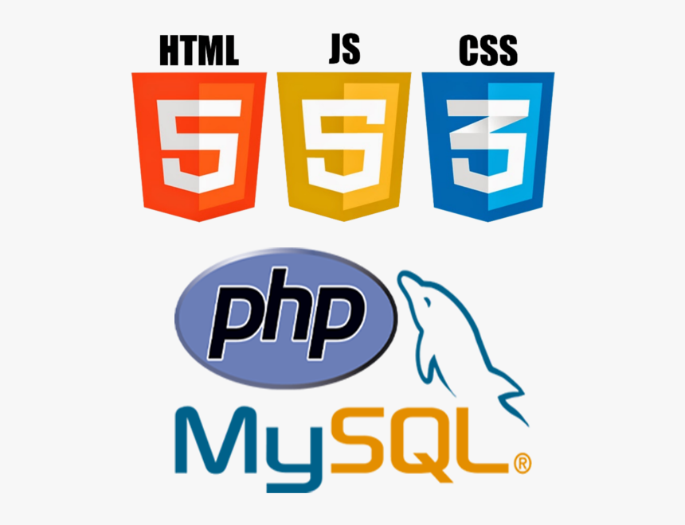



Designing & Writing the Code
Implement Structure with HTML
Design with CSS
Make Dynamic with JS
Connect Database using PhP
PPT Designed by Md. Abdul Kaiyum | 7

Slide 8
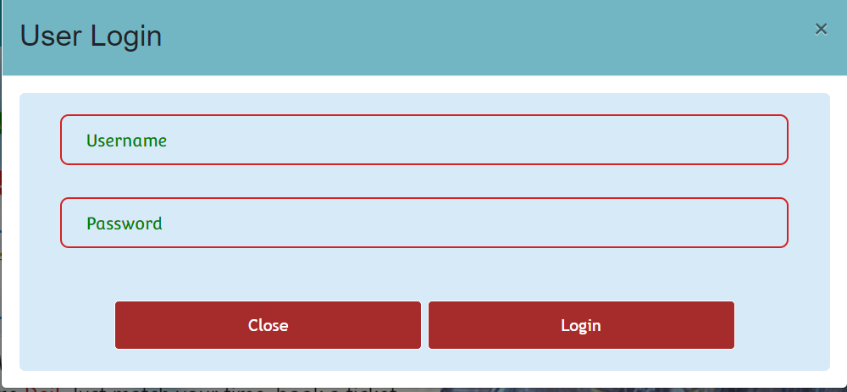
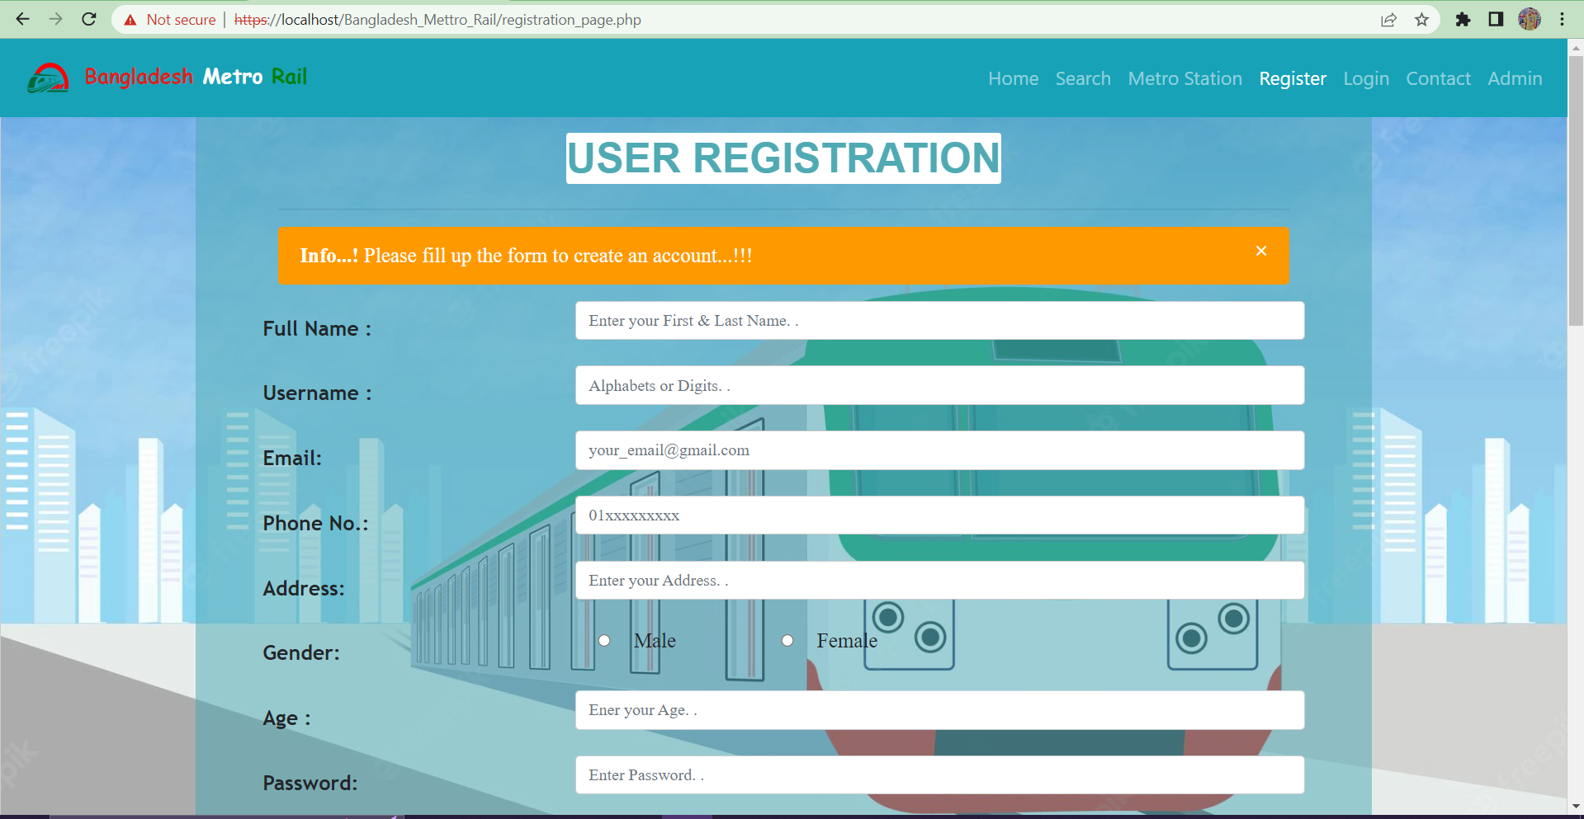
How The Project Works
How?
Matches the credentials
Switches web pages
Takes inputs
Adds data to database(Table)
Retrieve data from database(Table)
PPT Designed by Md. Abdul Kaiyum | 8

Slide 9
Benefits & Complexity
Benefits
➢ Can be use in any institutional transport sector.
➢ Both User and Organization can use.
➢ All options are in one place.
➢ Updatable according to our need.
➢ Simple & easy to use.
Complexities Of Our Project
Complex Designing Process.
Cost can be an issue.
PPT Designed by Md. Abdul Kaiyum | 9

Slide 10
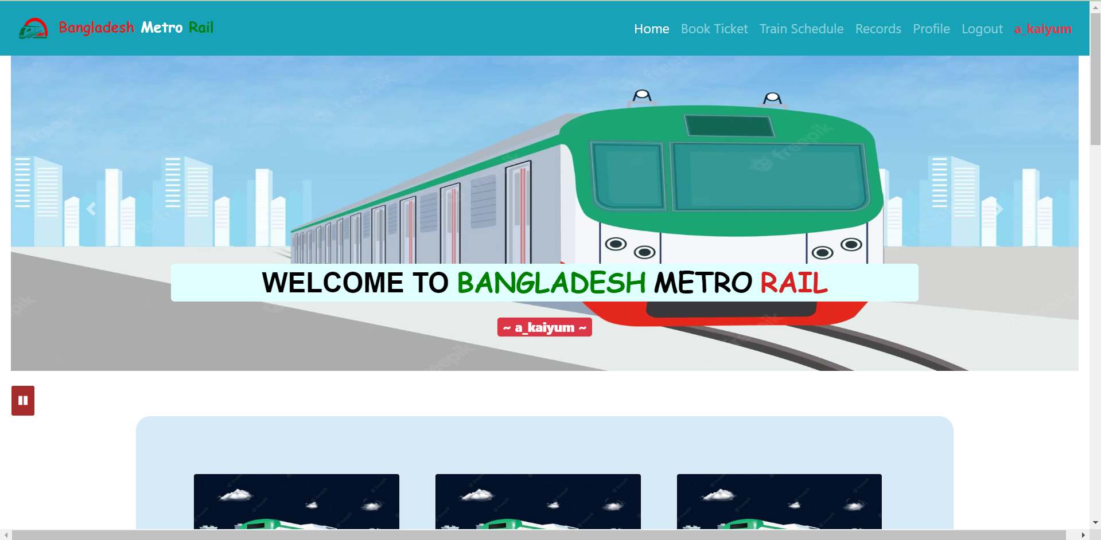
Scope of Future Work
Future Use
Can work with large Database.
Can be implement in any large transport sector.
Can be add any Payment Method.
PPT Designed by Md. Abdul Kaiyum | 10

Slide 11


Slide 12
THANK YOU

